Slide 1
Section 8.3
Trigonometric Equations
Copyright © 2012 Pearson Education, Inc. Publishing as Prentice Hall.

Slide 2

Copyright © 2012 Pearson Education, Inc. Publishing as Prentice Hall.

Slide 3

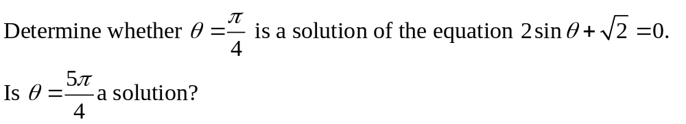
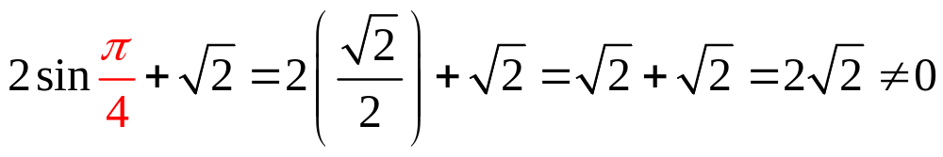
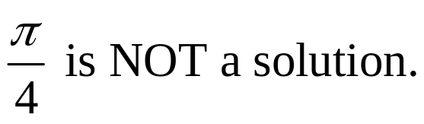
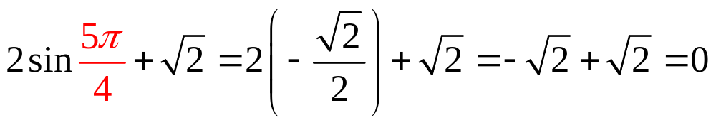
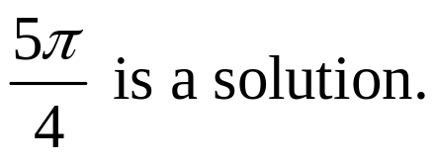
Copyright © 2012 Pearson Education, Inc. Publishing as Prentice Hall.

Slide 4
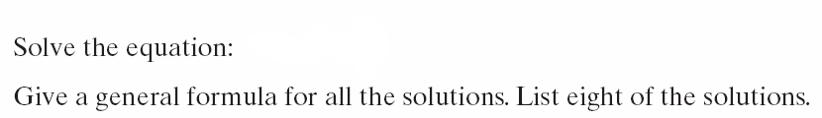
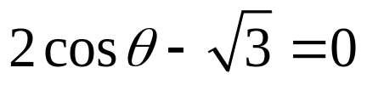
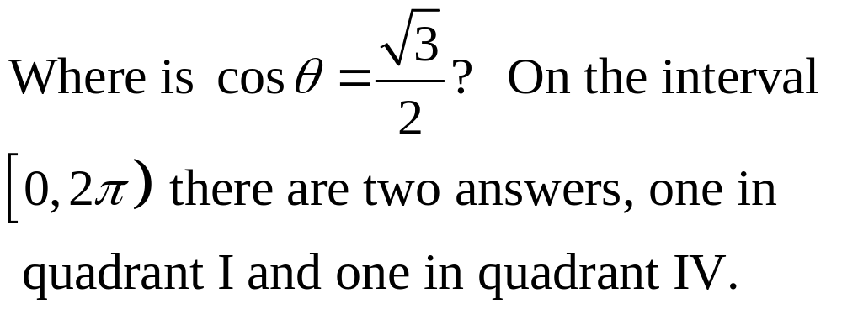
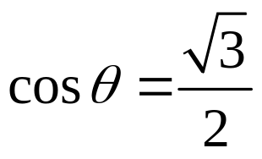
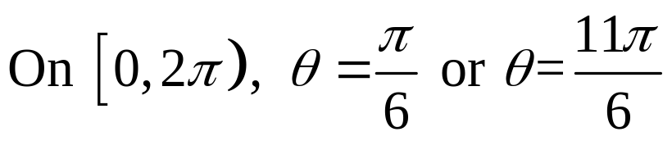
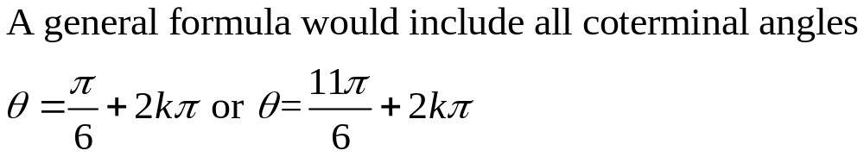
Copyright © 2012 Pearson Education, Inc. Publishing as Prentice Hall.

Slide 5
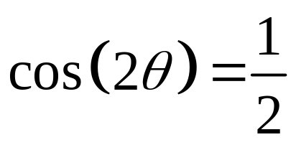
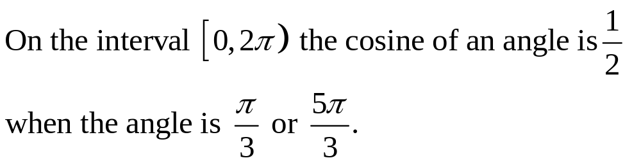
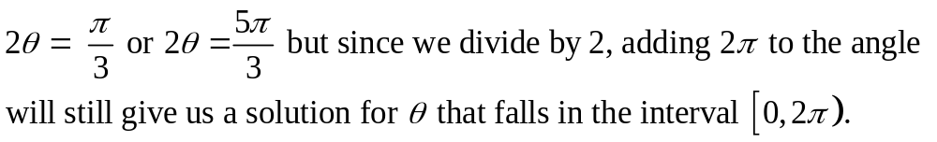
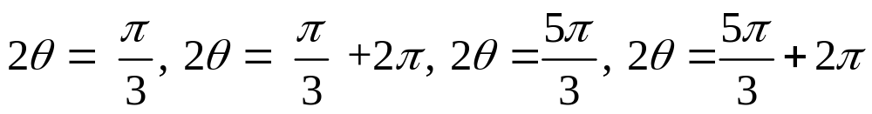
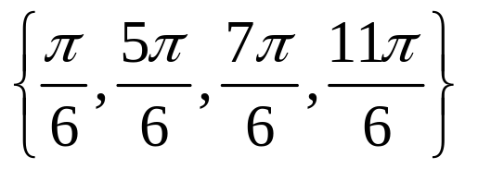
Copyright © 2012 Pearson Education, Inc. Publishing as Prentice Hall.

Slide 6
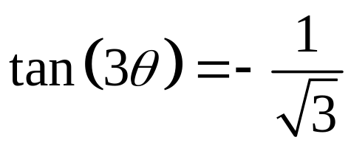
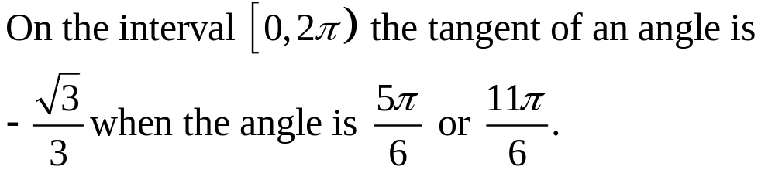
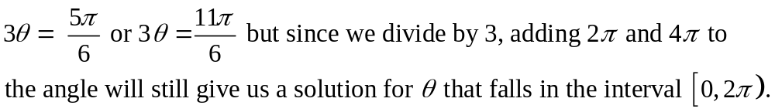
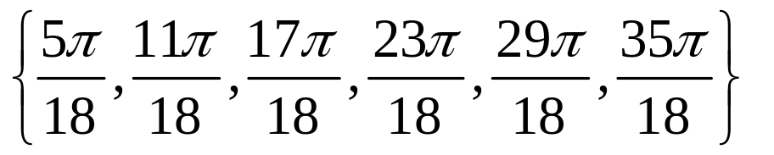
Copyright © 2012 Pearson Education, Inc. Publishing as Prentice Hall.

Slide 7
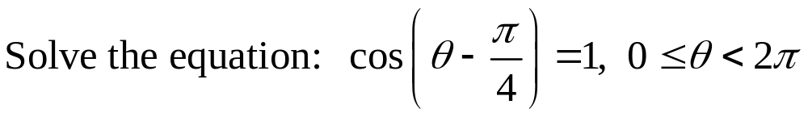
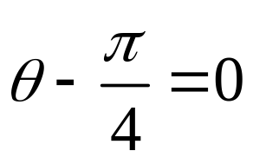
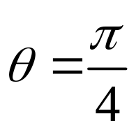
Copyright © 2012 Pearson Education, Inc. Publishing as Prentice Hall.

Slide 8
Copyright © 2012 Pearson Education, Inc. Publishing as Prentice Hall.

Slide 9

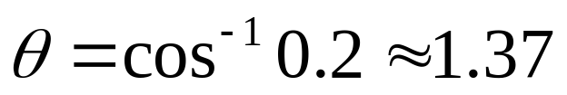
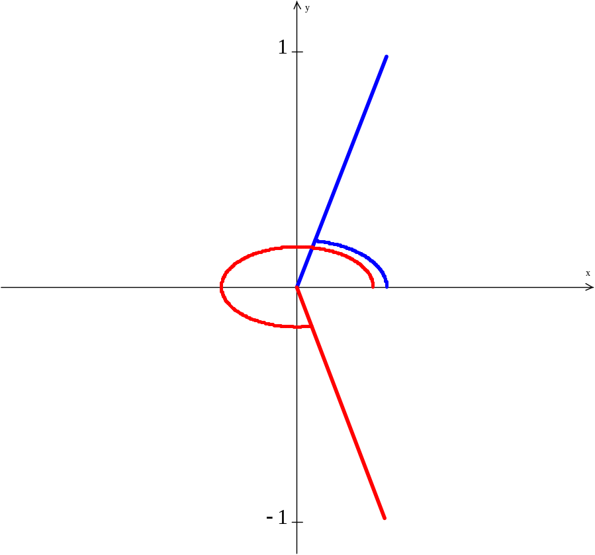


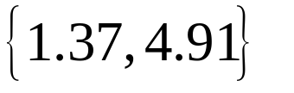
For inverse cosine the calculator will only give an angle from 0 to π. There is another angle in the interval from 0 to 2π with that cosine value in quadrant IV.
Copyright © 2012 Pearson Education, Inc. Publishing as Prentice Hall.

Slide 10
Copyright © 2012 Pearson Education, Inc. Publishing as Prentice Hall.

Slide 11
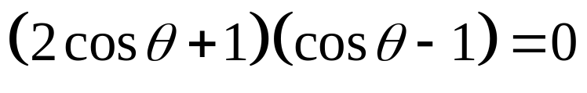
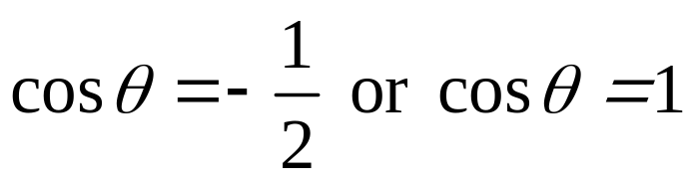
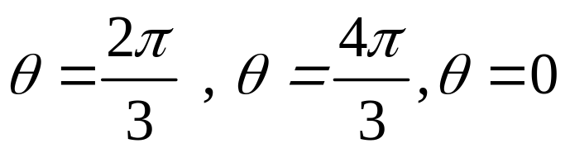
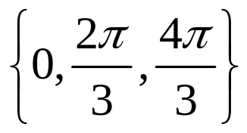
Copyright © 2012 Pearson Education, Inc. Publishing as Prentice Hall.

Slide 12
Copyright © 2012 Pearson Education, Inc. Publishing as Prentice Hall.

Slide 13


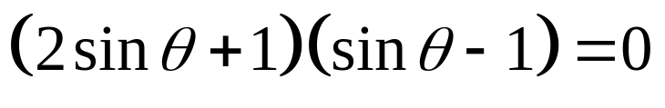

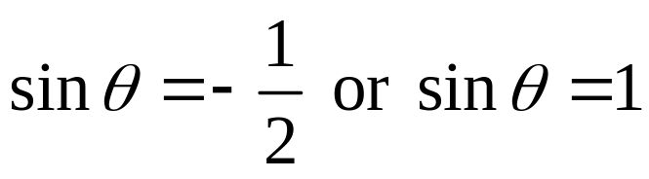
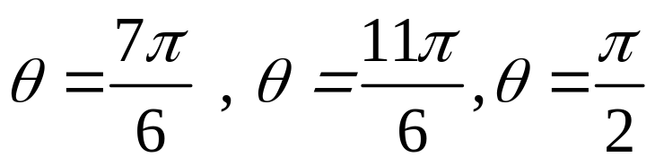
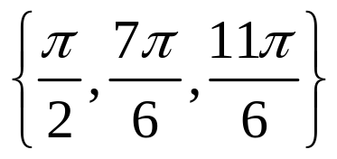
Copyright © 2012 Pearson Education, Inc. Publishing as Prentice Hall.

Slide 14
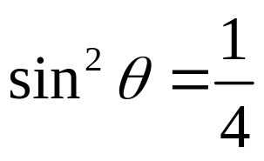


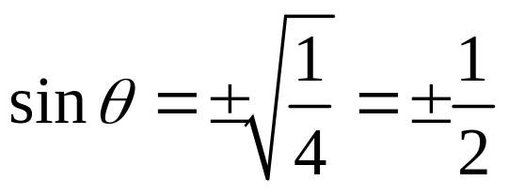
Copyright © 2012 Pearson Education, Inc. Publishing as Prentice Hall.

Slide 15
Copyright © 2012 Pearson Education, Inc. Publishing as Prentice Hall.

Slide 16

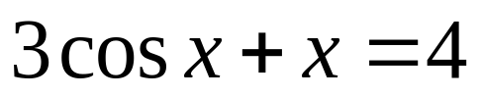


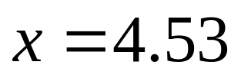
This cannot be solved by previous methods but can be solved using a graphing utility.
Y₁= 3cos x + x Y₂ = 4
Use INTERSECT to find solutions.
Copyright © 2012 Pearson Education, Inc. Publishing as Prentice Hall.

